Slide 1
THE LIFE OF CHRIST
PART 13

Slide 2
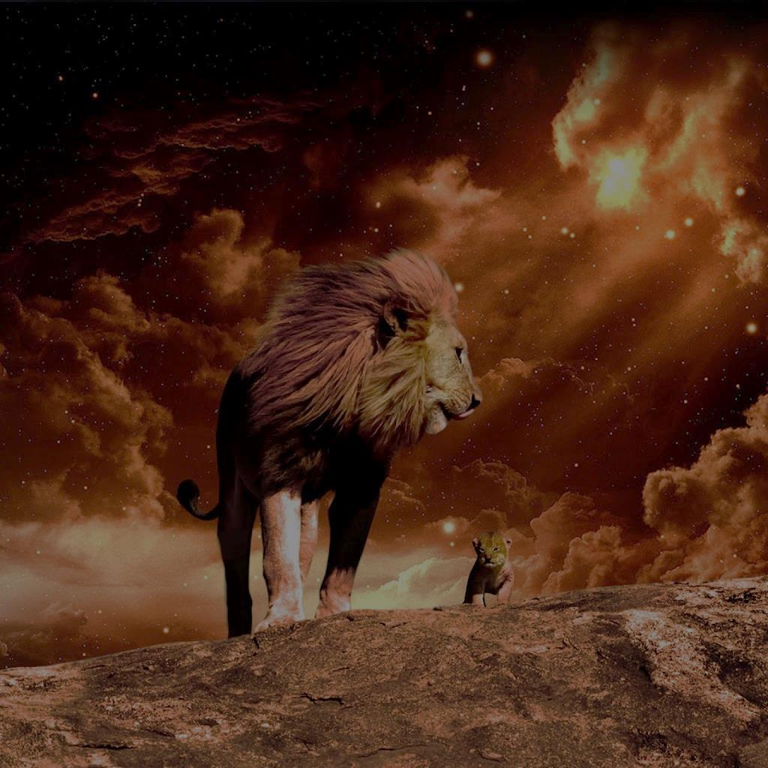
Luke 3:18 And with many other exhortations he preached to the people. ¹⁹ But Herod the tetrarch, being rebuked by him concerning Herodias, his brother Philip's wife, and for all the evils which Herod had done, ²⁰ also added this, above all, that he shut John up in prison.

Slide 3
Matthew 4:12 Now when Jesus heard that John had been put in prison, He departed to Galilee. See also Mk. 1:14.

Slide 4
John 4:1 Therefore, when the Lord knew that the Pharisees had heard that Jesus made and baptized more disciples than John ² (though Jesus Himself did not baptize, but His disciples), ³ He left Judea and departed again to Galilee. ⁴ But He needed to go through Samaria.
Why did He need to go through Samaria?

Slide 5
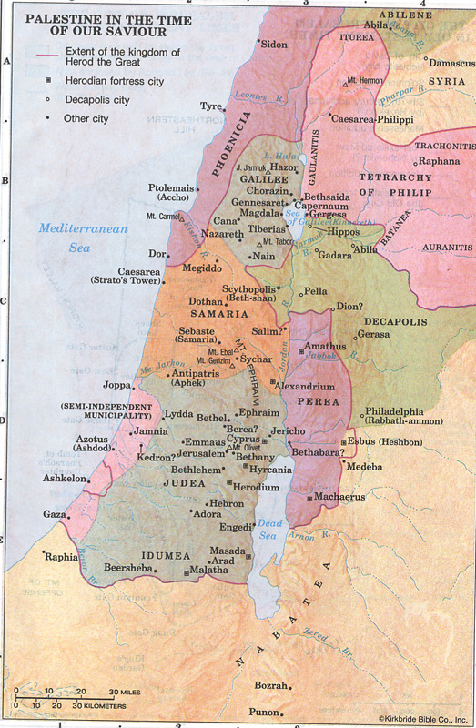

Slide 6
The territory of Samaria was comprised of two tribes, Ephraim and part of Manasseh. After the children of Israel divided into two kingdoms, king Omri started building the city of Samaria around 880 B.C. and his son Ahab finished its construction around 874 – 853 B.C. This city became the capital of Israel. Due to Israel’s constant disobedience to God, the Assyrians captured their capital around 722 – 721 B.C. and many of the Israelites were taken away to Assyria (2 Kgs. 17:23).

Slide 7
Next, Assyria takes over the city of Samaria and they bring in various foreigners (2 Kgs. 17:24). Not all the Israelites were gone because some would be left to work the vineyards and the fields and others had escaped (2 Chr. 30:6). These foreigners would eventually marry these Israelites and this is where the Samaritans got their start (2 Kgs. 17:29).

Slide 8
God sent lions to eat some of them because they did not fear God (2 Kgs. 17:25). They wanted to appease God, so they sent for a priest to teach them about the ways of God. From that point forward, they worshipped God, but they also continued worshipping their false gods as well (2 Kgs. 17:26ff).

Slide 9
The Samaritans offered to help Zerubbable rebuild the temple, but he refused their help. This made the Samaritans mad, so they tried to prevent the Jews from rebuilding the temple (Ezra 4:1-10). They also tried to prevent Nehemiah from rebuilding the wall of Jerusalem (Neh. 2:10 – 6:14). When Ezra commanded the Jews to divorce their pagan wives (Ezra 9 – 11), this divided the Jews from the Samaritans even more.

Slide 10
According to Josephus, the final event that would forever separate the Jews from the Samaritans was when they built a temple on Mount Gerizim (Ant., XI, vii, 2; viii, 2 ff). They claimed this area, known as Shechem, as being the true “Bethel” (house of God) instead of Jerusalem (Nelson New Illustrated Bible Dictionary p.1120).

Slide 11
The Samaritans were almost destroyed by the Romans in A.D. 527 – 565. However, two small groups still exist today in Nablus (ancient Shechem) and near Tel Aviv (Nelson New Illustrated Bible Dictionary p. 1120).

Slide 12
John 4:5 So He came to a city of Samaria which is called Sychar, near the plot of ground that Jacob gave to his son Joseph. ⁶ Now Jacob's well was there. Jesus therefore, being wearied from His journey, sat thus by the well. It was about the sixth hour.

Slide 14
J. W. McGarvey wrote:
Jacob's well is still there, about one hundred feet from Mount Gerizim, which rises high above it to the west. The well is a perfect cylinder, seven and a half feet in diameter, walled with stones of good size, smoothly dressed, and nicely fitted together, an excellent piece of masonry. Its depth was stated by the earliest modern who visited it (Maundrel) at 105 feet with fifteen feet of water. In 1839, it was found to be seventy-five feet deep with ten or twelve feet of water. All visitors of more recent date have found it dry and gradually filling up from the habit of throwing stones into it to hear the reverberation when they strike the bottom (J. W. McGarvey, The Fourfold Gospel (Cincinnati, Ohio: The Standard Publishing Company, 1914), p. 56).

Slide 15
Jacobs Well, today, is located in a dark crypt of a church, surrounded with icons and candles. A Byzantine Church was built over the well which was destroyed in 1187. In 1860, the Greek Orthodox Church restored the crypt, and in 1914 began the restoration of the Church. In 1960 "it was still unfinished. There were two small structures not unlike builders huts which cover two stone stairways down into the crypt. Water is drawn which is clear and drinkable (hitch.south.cx/Jacobs-well.htm).

Slide 16
⁶ Now Jacob's well was there. Jesus therefore, being wearied from His journey, sat thus by the well. It was about the sixth hour.

Slide 17
John 4:7 A woman of Samaria came to draw water. Jesus said to her, "Give Me a drink." ⁸ For His disciples had gone away into the city to buy food. ⁹ Then the woman of Samaria said to Him, "How is it that You, being a Jew, ask a drink from me, a Samaritan woman?" For Jews have no dealings with Samaritans. ¹⁰ Jesus answered and said to her, "If you knew the gift of God, and who it is who says to you, 'Give Me a drink,' you would have asked Him, and He would have given you living water." ¹¹ The woman said to Him, "Sir, You have nothing to draw with, and the well is deep. Where then do You get that living water? ¹² "Are You greater than our father Jacob, who gave us the well, and drank from it himself, as well as his sons and his livestock?"

Slide 18
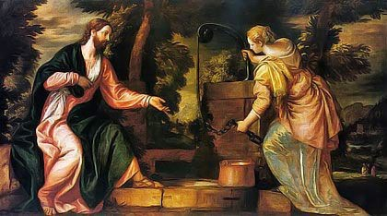
John 4:7 A woman of Samaria came to draw water. Jesus said to her, "Give Me a drink." ⁸ For His disciples had gone away into the city to buy food. ⁹ Then the woman of Samaria said to Him, "How is it that You, being a Jew, ask a drink from me, a Samaritan woman?" For Jews have no dealings with Samaritans. ¹⁰ Jesus answered and said to her, "If you knew the gift of God, and who it is who says to you, 'Give Me a drink,' you would have asked Him, and He would have given you living water." ¹¹ The woman said to Him, "Sir, You have nothing to draw with, and the well is deep. Where then do You get that living water? ¹² "Are You greater than our father Jacob, who gave us the well, and drank from it himself, as well as his sons and his livestock?"

Slide 19
John 4:13 Jesus answered and said to her, "Whoever drinks of this water will thirst again, ¹⁴ "but whoever drinks of the water that I shall give him will never thirst. But the water that I shall give him will become in him a fountain of water springing up into everlasting life." ¹⁵ The woman said to Him, "Sir, give me this water, that I may not thirst, nor come here to draw."

Slide 20
Sometimes this idea of living water represents the receiving of the Holy Spirit (Jn. 7:37-39). Other times it is used to represent eternal life in heaven (Rev. 22:1).

Slide 21
John 4:16 Jesus said to her, "Go, call your husband, and come here." ¹⁷ The woman answered and said, "I have no husband." Jesus said to her, "You have well said, 'I have no husband,' ¹⁸ "for you have had five husbands, and the one whom you now have is not your husband; in that you spoke truly."

Slide 22
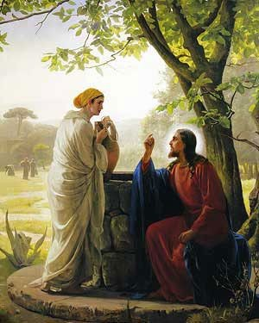

Slide 23
John 4:19 The woman said to Him, "Sir, I perceive that You are a prophet.

Slide 24
John 4:20 "Our fathers worshiped on this mountain, and you Jews say that in Jerusalem is the place where one ought to worship."

Slide 25
John 4:20 "Our fathers worshiped on this mountain, and you Jews say that in Jerusalem is the place where one ought to worship."

Slide 26
John 4:21 Jesus said to her, "Woman, believe Me, the hour is coming when you will neither on this mountain, nor in Jerusalem, worship the Father. ²² "You worship what you do not know; we know what we worship, for salvation is of the Jews.

Slide 27
John 4:23 "But the hour is coming, and now is, when the true worshipers will worship the Father in spirit and truth; for the Father is seeking such to worship Him. ²⁴ "God is Spirit, and those who worship Him must worship in spirit and truth."

Slide 28
What is a true worshipper?

Slide 29
As Christians, we need to understand that God has given us His fully revealed Word in our Bibles, and it contains everything we need to know about worshipping Him (2 Tim. 3:16-17; 2 Pet. 1:3), which is why Paul told the Corinthians, “…Not to think beyond what is written (1 Cor. 4:6).

Slide 30
This is why we are instructed not to add or take away from the Word of God (Rev. 22:18). If we go outside God’s pattern, then we are worshiping Him in vain (Mk. 7:6-7), and we will not be pleasing to the Father or the Son (2 Jn. 1:9). We should never think so highly of ourselves that we think we can devise something outside God’s Word that will please Him (Acts 17:24-25).

Slide 31
²⁴ "God is Spirit, and those who worship Him must worship in spirit and truth."

Slide 32
John 4:25 The woman said to Him, "I know that Messiah is coming" (who is called Christ). "When He comes, He will tell us all things." ²⁶ Jesus said to her, "I who speak to you am He."

Slide 33
John 4:27 And at this point His disciples came, and they marveled that He talked with a woman; yet no one said, "What do You seek?" or, "Why are You talking with her?"

Slide 34
John 4:28 The woman then left her waterpot, went her way into the city, and said to the men, ²⁹ "Come, see a Man who told me all things that I ever did. Could this be the Christ?" ³⁰ Then they went out of the city and came to Him.

Slide 35
John 4:31 In the meantime His disciples urged Him, saying, "Rabbi, eat." ³² But He said to them, "I have food to eat of which you do not know." ³³ Therefore the disciples said to one another, "Has anyone brought Him anything to eat?" ³⁴ Jesus said to them, "My food is to do the will of Him who sent Me, and to finish His work.

Slide 36
“I have not departed from the commandment of His lips; I have treasured the words of His mouth More than my necessary food” (Job 23:12).

Slide 37
John 4:35 "Do you not say, 'There are still four months and then comes the harvest'? Behold, I say to you, lift up your eyes and look at the fields, for they are already white for harvest! ³⁶ "And he who reaps receives wages, and gathers fruit for eternal life, that both he who sows and he who reaps may rejoice together. ³⁷ "For in this the saying is true: 'One sows and another reaps.' ³⁸ "I sent you to reap that for which you have not labored; others have labored, and you have entered into their labors."

Slide 38
John 4:39 And many of the Samaritans of that city believed in Him because of the word of the woman who testified, "He told me all that I ever did." ⁴⁰ So when the Samaritans had come to Him, they urged Him to stay with them; and He stayed there two days. ⁴¹ And many more believed because of His own word. ⁴² Then they said to the woman, "Now we believe, not because of what you said, for we ourselves have heard Him and we know that this is indeed the Christ, the Savior of the world."

